Slide 1
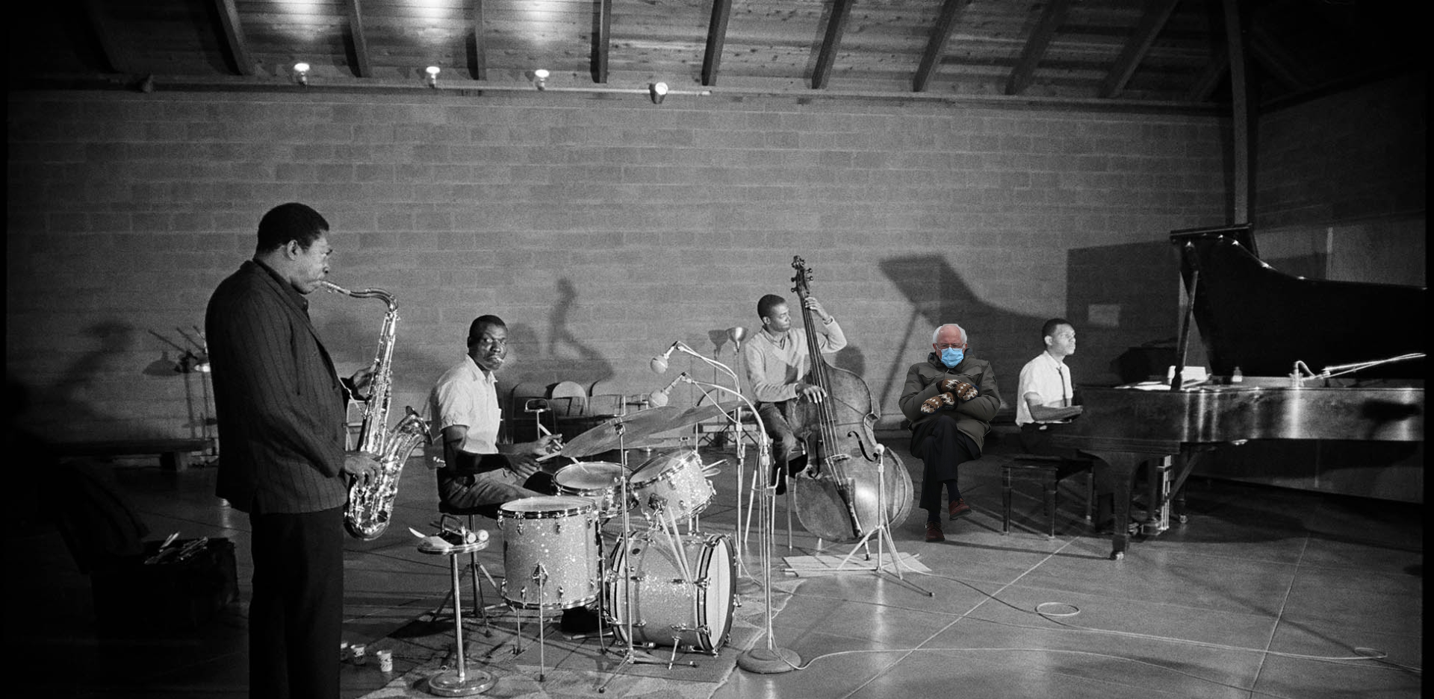
2 New tasks: Jazznets & Emojis
Hannah Merseal
5 Feb. 2021
CNCL Meeting

Slide 2
Semantic distance
Semantic memory is represented as networks of words and their defining linguistic features
Word = node, relationship = edge
Semantic Distance Task (SDT) relates path length to semantic distance (Kenett et al. 2017)
Related words are “closer” than unrelated words
Shorter path lengths
Higher relatedness judgements
Faster RT

Slide 3

Jazz? Nets?
Much research looking at underlying cognitive mechanisms of improvisation
But what is the nature of improvisers’ knowledge structure?
Can we apply network science methods to study music?
Learning patterns
Referencing patterns
Reorganizing patterns for
Production in performance

Slide 4





Stimuli
Calculated a network from the Weimar Jazz Database (WJD)
Nodes = 5-note sequences
Edges = continuations to other sequences
Distance = 1
Distance = 20
Distance = 2

Slide 5

Stimuli
We converted these pairs into MIDI samples
Task used distances 1, 2, 3, 4, 6, 10, & 20
1 - 4 related (overlap)
6, 10, 20 unrelated (no overlap)

Slide 6
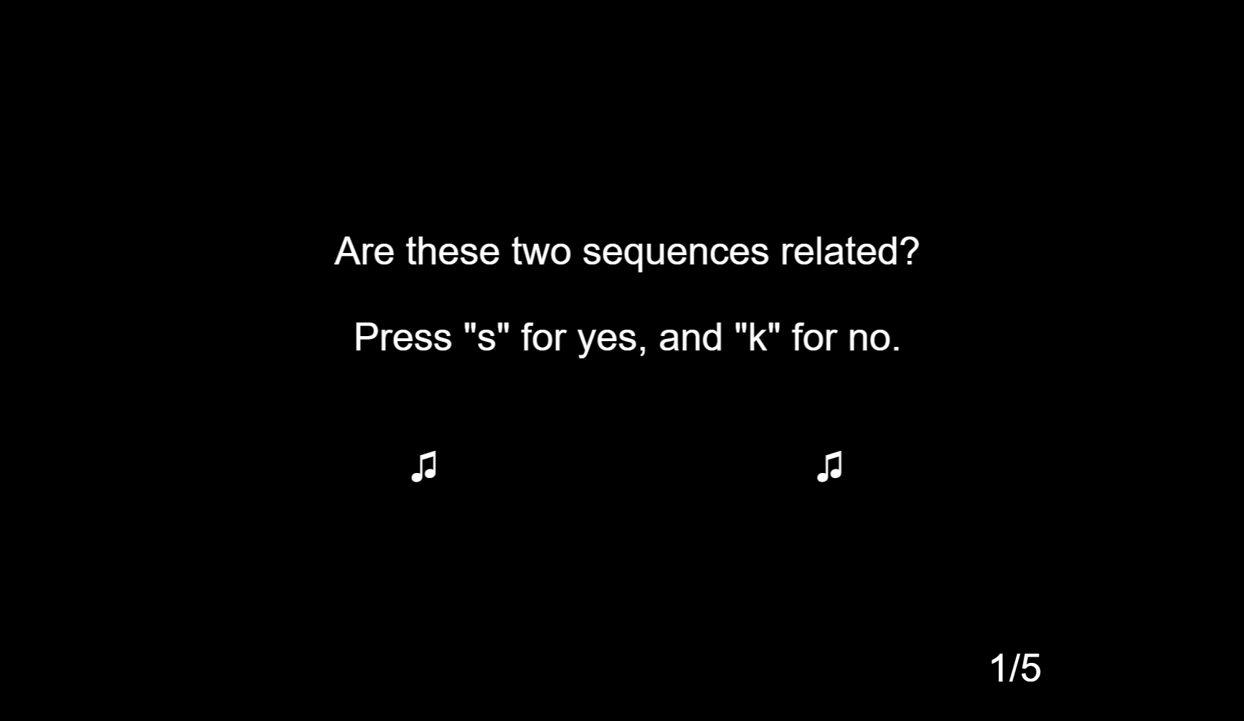
Melodic Relatedness Task
Adapted from the Kenett et al. (2017) Semantic Distance Task (SDT)

Slide 7
Procedure
58 participants recruited from Prolific
27 musicians (currently play an instrument), 31 non-musicians
Melodic Relatedness Task
7 conditions (1, 2, 3, 4, 6, 10, 20), 40 pairs per condition
~ 40-50 minutes with breaks
Survey
Music listening habits
Musical background & experience
Jazz-specific

Slide 8
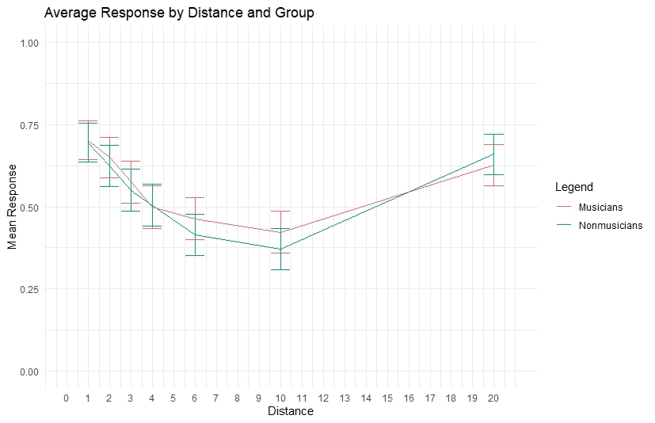
What’s up with 20?

Slide 9
Responses
Logistic regression (response ~ distance + musicianYN + distance*musicianYN + hours/week music listening + hours/week jazz listening) w/o 20
Each 1-unit increase in distance decreased relatedness, p < .001
Music listening increased relatedness odds, p < .001
Jazz listening decreased relatedness odds, p < .001
Musicianship not significant
Musician*distance intx not significant

Slide 10
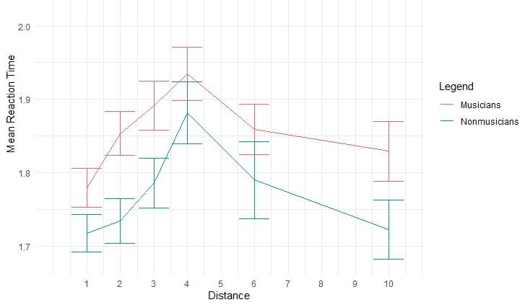
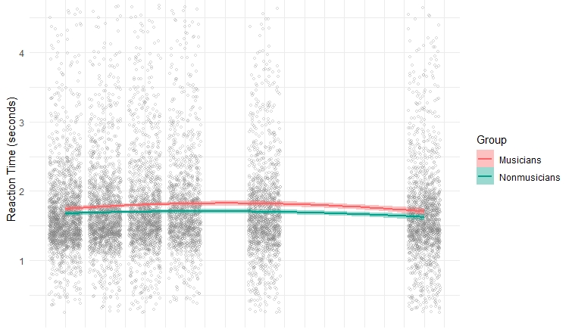
RT
Excluded “incorrect” trials disaligned with a priori designation
Quadratic relationship between distance and RT
Similar to Kenett et al. in language paper

Slide 11
Next steps
Conclusion: we can use network science methods to study music, preliminary evidence for melodic networks akin to semantic networks
Study with improvisers (jazz students vs. professionals)
Jazz vs. classical comparison
Follow-up study with higher distances

Slide 12




Now for something completely different

Slide 13
We can do better
RAT is a great measure of convergent thinking
AUT is a great measure of divergent thinking
RAT doesn’t capture DT, AUT doesn’t capture CT -> ideal measure of creative thinking will have both

Slide 14



Cool new task

Slide 15
“The turtle rode in the helicopter.”
“The turtle ate a taco in the helicopter.”
Uses all 3 cues, but isn’t particularly novel
“The turtle used the helicopter to steal Taco Bell’s secret recipe.”
Only uses 2 cues, trouble with convergent thinking

Slide 16
3-cue story generation task has been done (Howard-Jones et al. 2005)
Icons -> flexibility of interpretation
Taco = Mexican food, general lunch, Tuesday
Can manipulate semantic distance of cues
Soliciting ideas from CNCL

